Slide 1
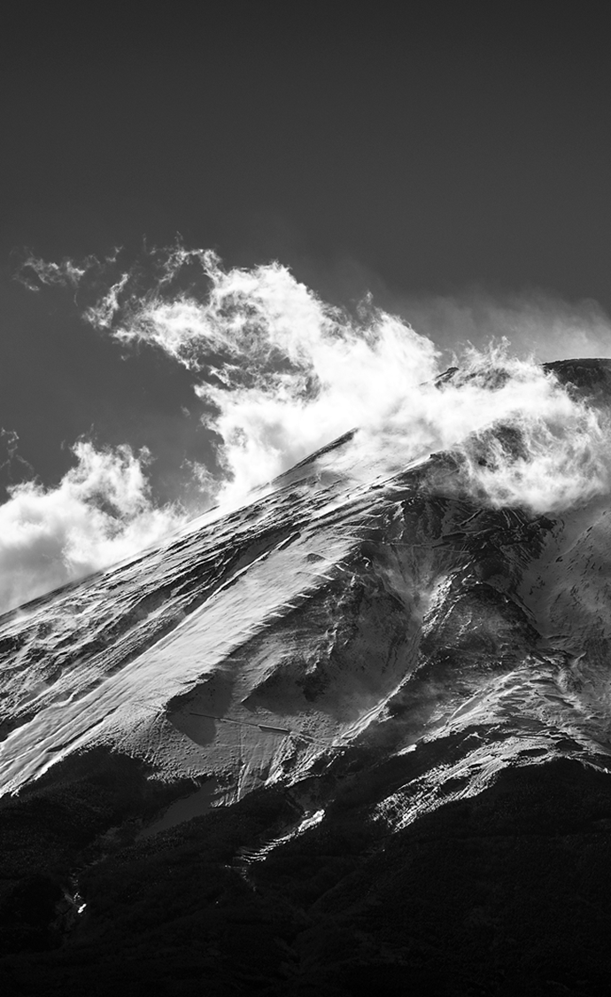
FLOOD FORECASTING
Presented by Gabriel Santiago B.

Slide 2
agenda
Introduction
Data
Model
Conclusion

Slide 3
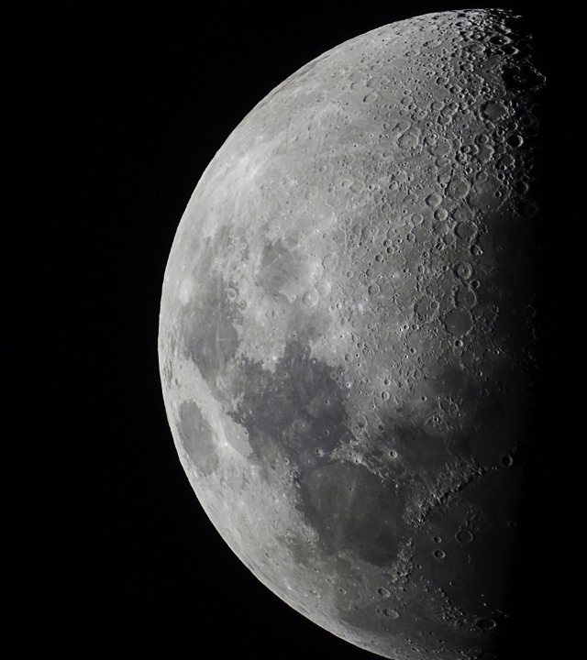
Introduction

Slide 4
PrOBLEMATIC
-1.5% PIB
+245k affected families
Peru is an Emerging Market Economy with sustained economic growth. However, as many Latin-American countries, it has not been unrelated to climate change.

Slide 5
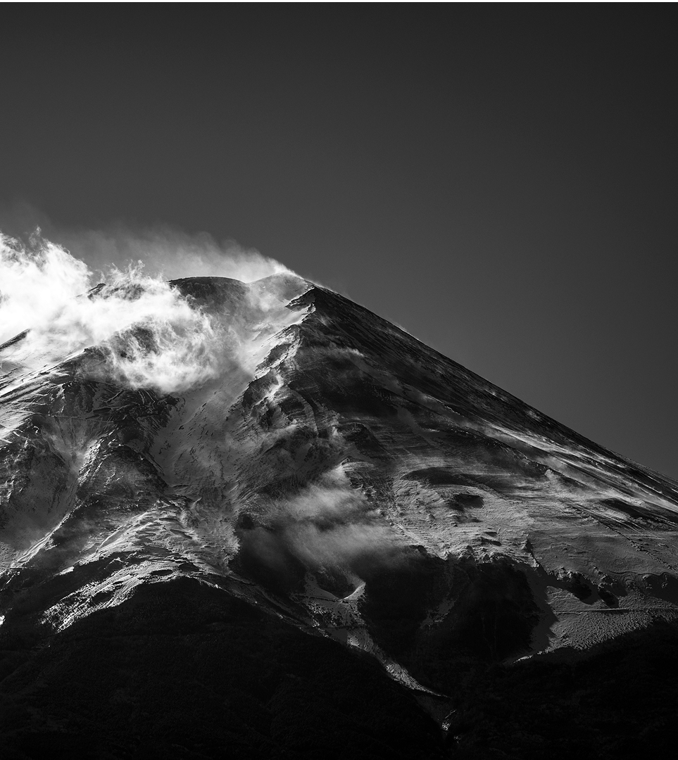
DATA

Slide 6
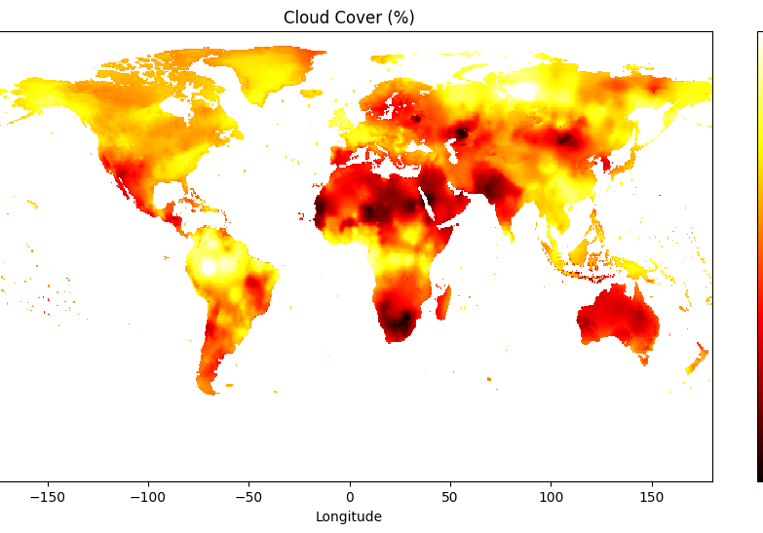
DATA SOURCES
Gridded Time Series Dataset
Set of month, latitude and longitude information of:
Country Aggregates Dataset
Set of month, and country average of above-mentioned variables.
Cloud Coverage (%)
Temperature Range
Frost Days
Potential evapo-transpiration
Precipitation rate
Minimum temperature
Maximum temperature
Mean temperature
Vapour pressure
Wet days

Slide 7
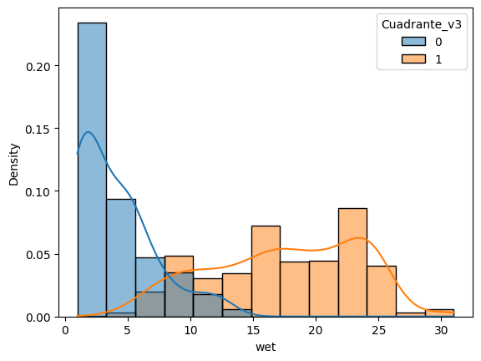
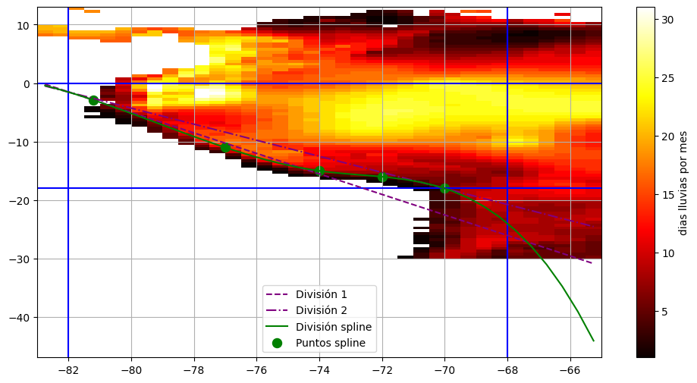
DATA PROCESSING
Latitude and Longitude Delimitation:
We filter latitude and longitude to contain Perú.
Regions Creation:
We created 2 different Regions based on the target* distribution using cubic splines.
Target creation:
We used a 10 years rolling window to generate thresholds of the variable “Wet days” by region and then set to 1 the places where the value was above the calculated threshold.
Target Distribution based on created regions
Regions created based on target* and regional knowledge
* To be more precise, we used the distribution of the variable that was latter going to be used as target.

Slide 8

MOdel

Slide 9
ARCHITECTURE
Big Model
Small Model
ConvLSTM Layer:
We account for weather similarities between locations by using a Convolutional Layer. We also account for the autoregressive nature of weather by combining by adding an LSTM to the architecture.
Dense Layer:
In other to give weather context of nearby countries without having to incur in more computational complexity by expanding the latitude and longitude thresholds, we use tabular data of country weather aggregates in a simple Dense Layer.
Ctry Agg
Temp Min
Temp Max
Wet
Ctry Agg
Temp Min
Dense Layer
Conv-LSTM
Conv-LSTM
Conv-LSTM
Dense Layer
Conv-LSTM
Embedded
Embedded
Conv-LSTM
Conv-LSTM
Probability of anormal rainfall
Probability of anormal rainfall

Slide 10
BENCHMARK
Logit Model:
To make sure that our approach is robust against more simple methodologies, we build a Logistic regression on the same target but without considering neither the time or proximity factors.

Slide 11

CONCLUSIONS & NEXT STEPS
Conclusions:
Multivariate works
We showed that giving more context on weather situation yields better performing models.
Complexity vs efficiency
Our results suggest that the complex approach led to inaccurate results, probably due to miss specification of the model (too much history for the LSTM).
Next Steps:
Change lags used for LSTM
For this version we used 8 years of data as lags for the LSTM (monthly data). That raised the complexity of the model without giving expected results.
GNN approach
Intuitively in our dataset there is a strong relation between records due to both time and proximity factors. This gives us the possibility to try a GNN approach.

Slide 12

Thank you
Presented by Gabriel Santiago

